Slide 1
NCSC research on the security of AI systems
Martin R3
- AI Security Research Outreach Lead
- NCSC Liaison Officer for University of Liverpool
June 2025
Notes:
Notes for completion:
Please ensure the slide deck has the appropriate Protective Marking, caveats and restrictions (eg Commercial etc)
Use of the slide deck isn’t mandatory but you must ensure that your review covers the following:
People:
Team structure, staffing levels, skills levels, in-third churn
Staff Survey Response and Actions
Delivery
High level objectives for the year (should link back to NCSC Strategy)
Progress this third - Broken down to cover Delivery, Research, Development
Workbook Dashboard – the Delivery team can create for you to run

Slide 2
Agenda
About the NCSC
Why do we care about AI security?
What are we doing about it?
Who do we work with?

Slide 3
About the NCSC

Slide 4

About the NCSC
Helping to make the UK the safest place to live and work online.
The UK’s National Cyber Security Centre
Established in 2016 as part of GCHQ
Hubs in Cheltenham, London and Manchester
Manchester will be the centre of growth for AI security

Slide 5

About the NCSC
Helping to make the UK the safest place to live and work online.
Understand cyber security. Distil this knowledge into practical guidance
Reduce risks to the UK by securing key public and private sector networks
Respond to cyber security incidents to reduce the harm they cause
Use industry and academic expertise to nurture the UK's cyber security capability

Slide 6

Research and academia
Internal research teams in many areas
For academia:
Public research problem book
ACE-CSRs – 21 universities including Liverpool and Manchester
ACE-CSEs
Research Institutes
Alan Turing Institute
Academic Liaison Officers

Slide 7
Why do we care about AI security?
Notes:
Notes for completion:
Please ensure the slide deck has the appropriate Protective Marking, caveats and restrictions (eg Commercial etc)
Use of the slide deck isn’t mandatory but you must ensure that your review covers the following:
People:
Team structure, staffing levels, skills levels, in-third churn
Staff Survey Response and Actions
Delivery
High level objectives for the year (should link back to NCSC Strategy)
Progress this third - Broken down to cover Delivery, Research, Development
Workbook Dashboard – the Delivery team can create for you to run

Slide 8

Why does the security of AI matter?
AI is proliferating incredibly fast. New models, tools and products are released regularly
AI systems can be large, complex and opaque
Very few people understand the security implications
This is the case for ‘traditional’ machine learning systems as well as frontier AI
Insecure AI is unsafe AI
Notes:
Probably don’t need this slide for this audience – but just a bit of context

Slide 9



Key NCSC thoughts
AI systems should be deployed securely and avoiding putting safety or personal data at risk.
We cannot rely on retrofitting security into AI systems. They should be Secure by Design.
AI will be used by good people for good things and bad people for bad things and we need to keep up with both.
OFFICIAL

Slide 10
Our research and what happens to it
Notes:
Notes for completion:
Please ensure the slide deck has the appropriate Protective Marking, caveats and restrictions (eg Commercial etc)
Use of the slide deck isn’t mandatory but you must ensure that your review covers the following:
People:
Team structure, staffing levels, skills levels, in-third churn
Staff Survey Response and Actions
Delivery
High level objectives for the year (should link back to NCSC Strategy)
Progress this third - Broken down to cover Delivery, Research, Development
Workbook Dashboard – the Delivery team can create for you to run

Slide 11
AI security research
We aim to:
Build a broad base of knowledge (National Technical Authority)
Do our own deep research on selected topics
Sponsor and fund suitable research in industry and academia
Build partnerships and grow the AI security community
In order to:
Produce useful advice and guidance
Help develop defensive tooling
Understand the threat to AI systems in the UK
Make the UK the safest place to live and work online

Slide 12
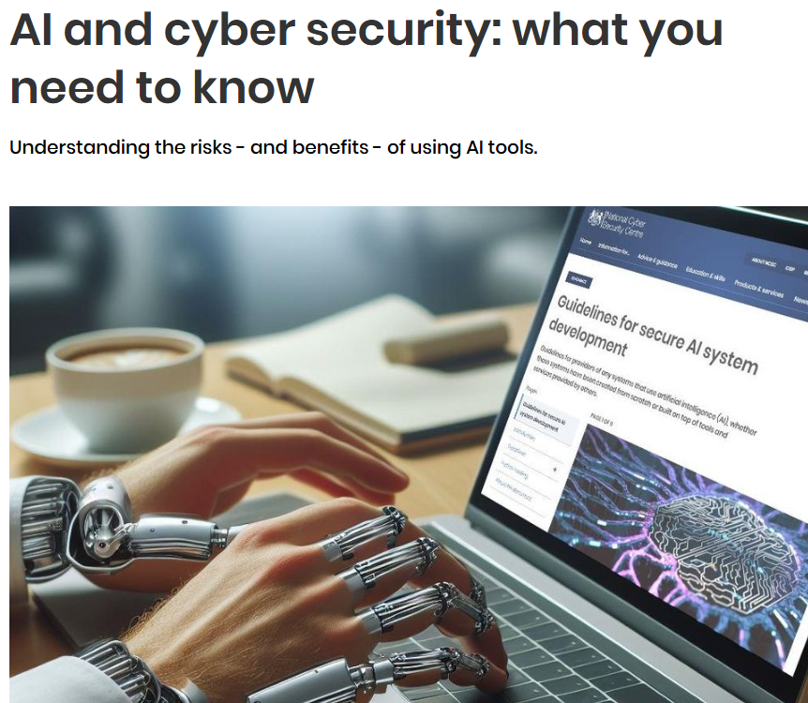



Published NCSC guidance…

Slide 13
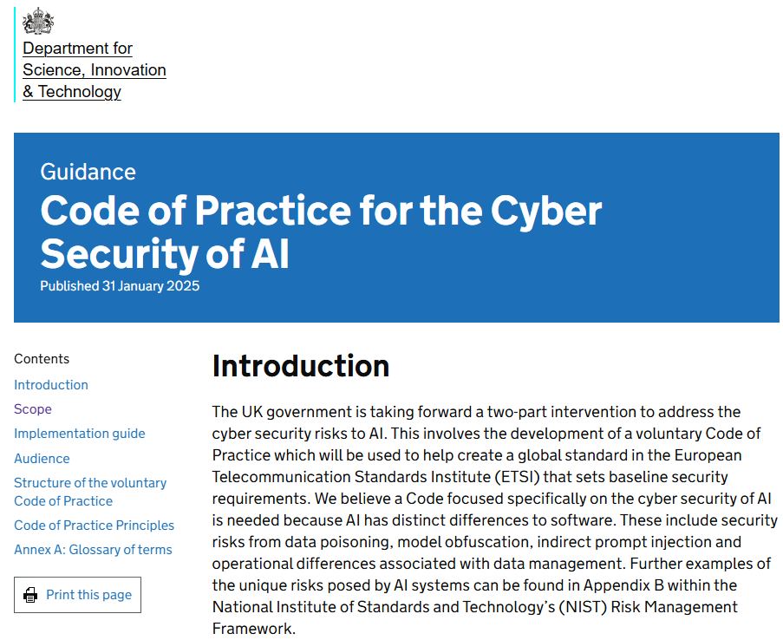
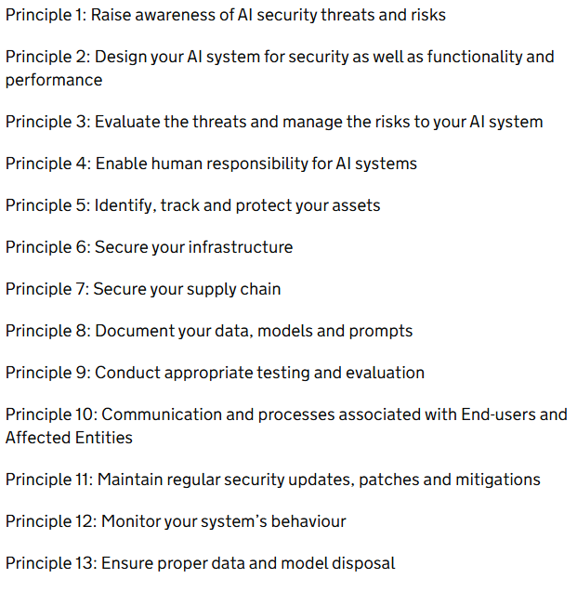
… informing policy and international standards
Notes:
Other publications:
AI and cyber security: what you need to know
Principles for the security of machine learning
The near-term impact of AI on the cyber threat
Obviously huge amount of guidance on other cyber security topics as well, some of which will overlap with AI – supply chain security, secure software development
Also several blogs and international co-seals
CeTAS paper on Standards in AI Security

Slide 14
Who do we work with?
Notes:
No pictures please
Notes for completion:
Please ensure the slide deck has the appropriate Protective Marking, caveats and restrictions (eg Commercial etc)
Use of the slide deck isn’t mandatory but you must ensure that your review covers the following:
People:
Team structure, staffing levels, skills levels, in-third churn
Staff Survey Response and Actions
Delivery
High level objectives for the year (should link back to NCSC Strategy)
Progress this third - Broken down to cover Delivery, Research, Development
Workbook Dashboard – the Delivery team can create for you to run

Slide 15

Our partnerships
Other parts of the NCSC
UK defence and security community
Wider UK government (including AISI)
Standards bodies
Industry
Academia (including via Alan Turing Institute, LASR, NWPST)

Slide 16

LASR - Laboratory for AI Security Research
Public-private partnership launched in 2024 to mitigate risks to and from AI, drive national resilience and position the UK as a global leader in AI security
Partners include:
Oxford University
Queen’s University Belfast
Alan Turing Institute
UK government including NCSC
Industry (Plexal)
https://lasr.plexal.com/

Slide 17
Summary
The NCSC’s mandate is to protect anyone that lives and works online in the UK.
Secure AI is foundational to safe, responsible and reliable AI. But AI is proliferating and changing extremely quickly, and security is hard.
We partner within and beyond the UK government on research that aims to raise the AI security bar.

Slide 18
Questions?
Notes:
No pictures please
Notes for completion:
Please ensure the slide deck has the appropriate Protective Marking, caveats and restrictions (eg Commercial etc)
Use of the slide deck isn’t mandatory but you must ensure that your review covers the following:
People:
Team structure, staffing levels, skills levels, in-third churn
Staff Survey Response and Actions
Delivery
High level objectives for the year (should link back to NCSC Strategy)
Progress this third - Broken down to cover Delivery, Research, Development
Workbook Dashboard – the Delivery team can create for you to run

